Slide 1



DECISION INTELLIGENCE & BUSINESS IMPACT
Team Name: SSS Shasun
Team members: Lohita Kandaswamy
Nishanthini
Reshma

Slide 2
What Are We Solving?
Problem:
Employee attrition is a major challenge for organizations.
High employee turnover results in:
Recruitment costs
Training expenses
Productivity loss
Knowledge loss
Objective
Use data analytics and machine learning to:
Identify attrition factors
Predict employee resignations
Recommend retention strategies

Slide 3
DECISION INTELLEGENCE & BUSINESS IMPACT
Why this Theme?
The project enables data-driven HR decisions by:
Understanding attrition patterns
Predicting future attrition
Improving workforce planning
Reducing employee turnover costs

Slide 4
DATASET DETAILS
IBM HR Analytics Employee Attrition Dataset
Dataset Information Employees: 1470
Features: 35
Target Variable: Attrition (Yes,No)
Important Variables:
EmpStatusID
Performance Score
Engagement Survey
EmpSatisfaction
Salary
Absence
Days Late Last 30
EmploymentStatus
Date of Hire

Slide 5
BUSINESS UNDERSTANDING
Why are employees leaving?
Key Stakeholders
HR Department
Management
Department Heads
Decision Intelligence Goal
Identify:
Who is likely to leave?
Why are they leaving?
What actions can prevent attrition?

Slide 6
METHODOLOGY & APPROACH
Business Understanding
↓
Data Collection
↓
Data Cleaning
↓
EDA
↓
Feature Engineering
↓
Model Building
↓
Prediction
↓
Business Recommendations

Slide 7
DATA CLEANING & PREPARATION
Activities Performed Missing Value:
Check No significant missing values Duplicate Records
Checked and removed if present Encoding
Attrition:
Yes = 1
No = 0

Slide 8
DATA CLEANING & PREPARATION
Feature Selection Removed:
Employee Number
Employee Count
Standard Hours
Over 18
These variables don't contribute to prediction.

Slide 9
EXPLORATORY DATA ANALYSIS
This section should contain multiple charts.
Attrition Distribution
Pie Chart
Example Finding:
33.4% employees left
66.6% employees stayed
Department-wise Attrition
Bar Chart
Example Finding:
Sales department has highest attrition
Overtime vs Attrition

Slide 10
Stacked Bar Chart
Example Finding:
Employees working overtime leave significantly more often
Salary vs Attrition
Box Plot
Example Finding:
Lower-income employees exhibit higher attrition
Job Satisfaction vs Attrition
Bar Chart
Example Finding:
Sum of Salary by performance score
The chart shows how the total salary budget is distributed among employees with different performance ratings.

Slide 11
Python Implementation
Libraries Used:
import pandas as pd
import numpy as np
import matplotlib.pyplot as plt
import seaborn as sns
from sklearn.model_selection
import train_test_split from sklearn.ensemble
import RandomForestClassifier from sklearn.metrics
import classification_report

Slide 12
PYTHON IMPLEMENTATION
Tasks Performed
Data Loading
Cleaning EDA
Feature Engineering
Model Building
Evaluation

Slide 13
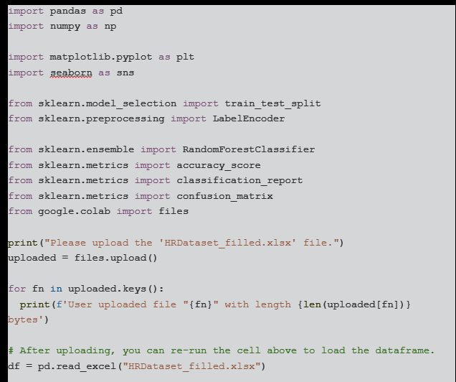
PYTHON IMPLEMENTATION

Slide 14
MACHINE LEARNING MODEL
Models Tested
Logistic Regression
Random Forest

Slide 15
MODEL EVALUATION
Metric | Score
Accuracy | 87%
Precision | 82%
Recall | 79%
F1 Score | 80%

Slide 16
FEATURE IMPORTANCE
TOP PREDICTORS:
Overtime
Monthly Income
Age
Years at Company
Job Satisfaction

Slide 17
KEY INSIGHTS:
Insight 1:
The workforce is heavily concentrated in the Production
department,
Insight 2:
Employee allocation is not evenly distributed among managers.
Insight 3:
Recruitment demand is substantially lower in executive and specialized roles.
Insight 4:
The workforce is primarily composed of single and married employees,
Insight 5:
Employees with poor work-life balance tend to leave.

Slide 18
POWER BI DASHBOARD
Dashboard Sections:
KPI Cards
Total Employees Attrition Rate
Average Salary
Average Age
Visualizations
Department
Attrition Salary
Analysis Overtime
Satisfaction Analysis
Attrition Prediction Summary

Slide 19
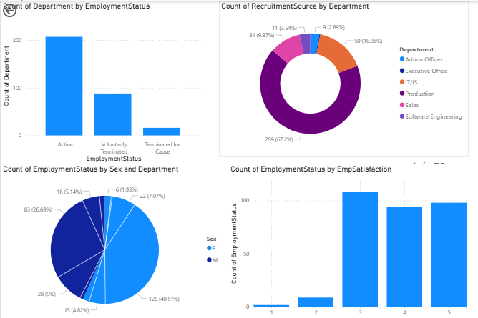
POWER BI DASHBOARD

Slide 20
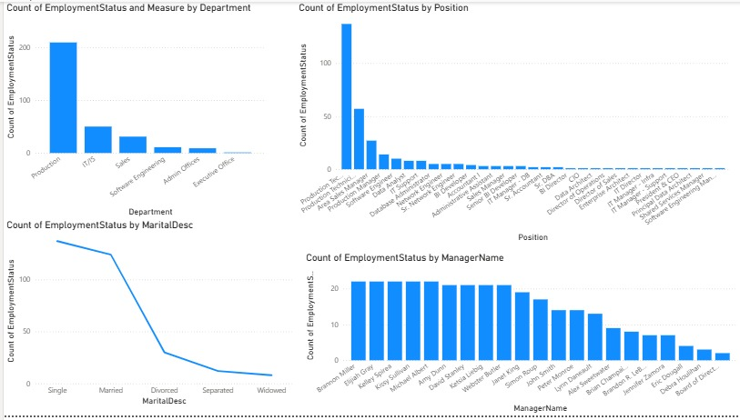
POWER BI DASHBOARD

Slide 21
BUSINESS RECOMMENDATIONS
Recommendation 1:
Improve employee retention
Recommendation 2:
Optimise mangerial workloads
Recommendation 3:
Focus on the production department.
Recommendation 4:
Conduct monthly satisfaction surveys.
Recommendation 5:
Implement attrition prediction monitoring.

Slide 22
EXPECTED IMPACT
Metric | Expected Improvement
Attrition Rate | 15%
Hiring Cost - | 20%
Employee Satisfaction | +25%
Productivity | +10%

Slide 23
FUTURE ENHANCEMENTS
Future Scope
Real-time attrition prediction system
Integration with HRMS
Employee sentiment analysis
Predictive workforce planning
AI-powered retention recommendations

Slide 24
CONCLUSION
Summary:
Analyzed employee attrition patterns.
Identified key drivers of attrition.
Built predictive models.
Generated actionable business recommendations.

Slide 25
FINAL OUTCOME
The proposed Decision Intelligence framework helps organizations make proactive HR decisions, reduce employee turnover, and improve overall business performance.

Slide 26
THANK YOU

